Slide 1
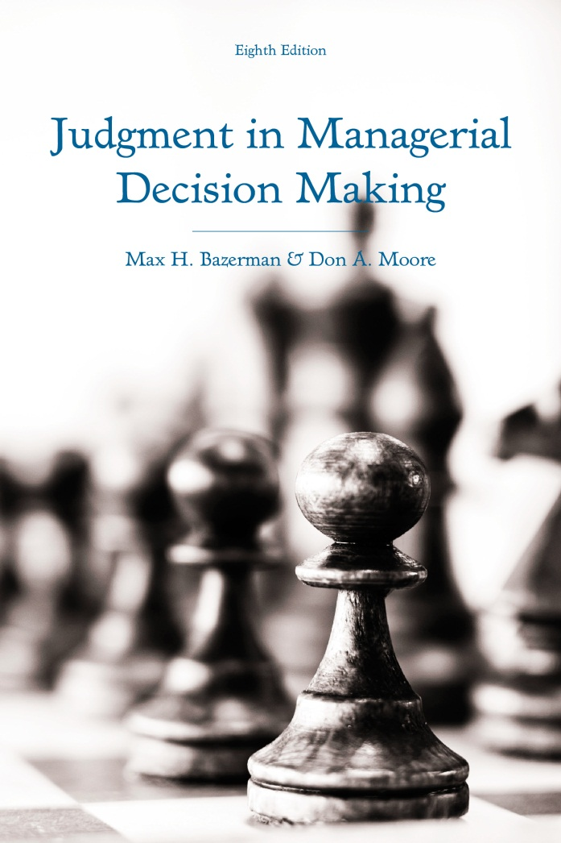
Judgment in Managerial Decision Making 8e
Chapter 6
Motivational and Emotional Influences on Decision Making
Copyright 2013 John Wiley & Sons
Notes:
As noted previously, we tend to use heuristics, or rules of thumb, to reduce the complexity of our decisions.
Often, these heuristics allow us to make effective decisions in a short amount of time.
However, under the right set of circumstances they can also lead us into making biased decisions.
Avoiding the biases that come with the use of heuristics is so difficult that even the most intelligent people are prone to error.
Before introducing key biases, take a few minutes to answer the following questions. Write down your answers.

Slide 2
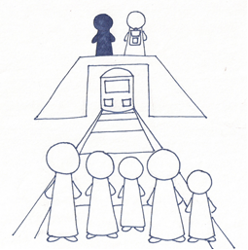
The Footbridge Dilemma
Notes:
Consider the following dilemma:
You are standing over a set of trolley tracks next to a railway worker with a backpack.
Below, you see the train rapidly approaching five helpless people.
The only way to save the people is by pushing the railway worker onto the tracks.
His body and the backpack will stop the train, but he will be killed.
You cannot jump in front of the train yourself because you do not weigh enough to stop the train and there is not enough time to put on the worker’s backpack.
Legal concerns aside, would you push the worker to his death?
This dilemma directly pits a utilitarian approach against a deontological approach.
Utilitarians think in terms of maximizing the number of lives saved, so killing one person is justified if it saves 5 others.
However, people with a deontological perspective believe that pushing the worker to his death is unjustified since it violates his rights.
In this problem, most people take the deontological perspective.

Slide 3
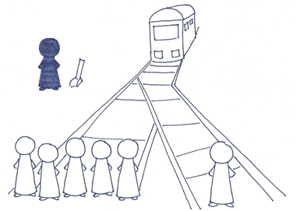
The Trolley (Switch) Problem
Notes:
Now, consider this problem.
A runaway trolley is rapidly approach five helpless workers. If it stays on course, all five workers will be killed.
The only way to save the workers is to flip a switch that leads the trolley onto a different track.
However, the trolley will kill one worker on the other track if you flip the switch.
Ignoring legal concerns, would you flip the switch to save five people at the expense of one other person?
This version of the problem is identical from a utilitarian perspective to the prior version of the problem.
However, most people choose to flip the switch in this version of the problem.
The indirect act of flipping a switch as opposed to directly pushing a person to his death is less emotionally arousing to people and leads them to think from a more utilitarian perspective.
Likewise, when people read both versions of this problem at the same time, they tend to adopt a more rational, utilitarian approach and change reconsider their answer to the footbridge problem by indicating that they would push the worker to his death.

Slide 4
Motivational and Emotional Influences
The want-should conflict
Self-serving perceptions of fairness
Emotional influences on judgment
Notes:
As illustrated by the prior two problems, we often make different decisions when we adopt an emotional perspective compared to a rational perspective.
One way this occurs is in the conflict between our ideal selves, or what we think we should do, and our less rational selves that seek immediate gratification.
Another is that we often develop perceptions of fairness that are biased by our own self-interest.
Finally, we also are prone to having our emotions influence our decisions.

Slide 5
When Emotion and Cognition Collide
Multiple selves
  Unique brain regions
  Joint versus separate evaluation
The impact of temporal differences
  Hyperbolic discounting
  Applications
Reconciling internal conflicts
  Commitment devices
  Communication between the two selves
  Compromise
Notes:
As mentioned, we constantly face conflict between what we want to do and what we know we should do.
One reason that this occurs is because what we want to do is heavily shaped by emotions while what we should do is shaped by more deliberative System 2 thinking.
The problem is that emotions and rational thought appear to be governed by different regions of the brain.
People with a damaged prefrontal cortex, a part of the brain associated with the coordination of information and decision-making, have difficulty regulating their behavior to be in line with their long-term goals.
People with damaged parts of the brain that are associated with emotions are actually more rational decision-makers than most because their emotions and instinctual reflexes are unlikely to drive them to make sub-optimal long-term decisions.
The inability to coordinate the regions of the brain associated with System 1 thought with the regions associated with System 2 thought likely explains the following common struggles that people face:
Drug addiction due to the inability to avoid the immediate gratification associated with taking an destructive drug.
Obesity resulting from the inability to avoid tasty but unhealthy foods.
Abstaining from extramarital sex despite the taboos associated with it.
Procrastinating by watching television rather than focusing on work with a rapidly approaching deadline.
As briefly mentioned earlier with the trolley and footbridge dilemmas, people tend to engage in more deliberative thought when they can directly weigh multiple options against one another.
Considering a single option causes people to think emotionally and reflexively.
But, when they have a point of comparison, they can more clearly see which choices are the most rational.
Time also seems to influence our decisions.
This occurs because we are hyperbolic discounters.
This means that when we consider choices in the present, we are less likely to delay gratification for a period of time than when we consider an identical time delay in the distant future.
For example, more people are less willing to hold off receiving $1 today in exchange for $2 tomorrow than they are to hold off receiving $1 365 days from now as opposed to $2 366 days from now.
If we were completely rational, we would be equally willing to delay gratification for an extra day regardless of how distant the decision is to delay gratification.
This tendency to be biased in favor of the present has important real-world applications.
Online movie renters are more likely to rent movies that they think they should watch (documentaries and art films) when they arrange to have them delivered several days later than they are when they order them to watch right now (they usually favor comedies and action films in the present).
A high proportion of online grocery orders are for healthy foods when they will be delivered several days from now, but when they will be delivered in the near future, a much higher proportion of unhealthy foods such as ice cream are ordered.
In public policy debates, we are more likely to approve policies in the long-term best interest when they will be implemented in the distant future as opposed to immediately implemented.
Most people are in favor of taxing gas, but they rarely vote for increasing gas taxes.
People generally are pro-environment, but they are typically unwilling to sacrifice the ability to consume certain product in the short term.
Homeowners face similar issues.
They typically do not invest enough in insulating their homes.
They fail to purchase energy-efficient appliances even though they will save money in the long-run.
The 2008 financial crash was incited by many homeowners defaulting on loans that they thought they could afford, which resulted in their homes being foreclosed.
Organizations also routinely fail to do what is in their long-term best interests, as they often worry about minimizing short-term costs without considering long-term cost-effectiveness.
Given all of the evidence that we have trouble engaging aligning our long-term best interest with our short-term behaviors, the key question is “how can we reconcile conflict between our two selves?”
One possible solution is to use commitment devices.
The purpose of commitment devices is to either make it impossible for ourselves to engage in a behavior that is not in our long-term best interest or to align our long-term and short-term best interests that makes it immediately painful to engage in an action that is not in our long-term best interest.
An example of a prevention strategy is to place oneself on a list that bans them from casinos in order to prevent themselves from gambling.
An example of a strategy that aligns short-term and long-term interests is the practice that some alcoholics employ where they take a drug that makes them extremely nauseous after consuming alcohol.
Another possible tactic is to consider the interests of both of our selves.
The downside to commitment devices is that they prevent the want self from winning out. However, in cases such a fight-or-flight reactions or when we are faced with hunger, it often makes sense for our want self to win out.
Thus, it may be a better solution to rationally consider our want selves and our should selves simultaneously. By considering the costs and benefits to allowing either of our selves to win out at a given point in time, we may be capable of determining which of our two selves should be attended to at a given point in time in order to make the decision that is best for us.
A final possible solution is to actively form a compromise solution that allows the want self to win out over the should self on occasion.
We are likely to be biased when simultaneously considering both selves such that our want self will likely win out more than it should.
Conversely, when we delay gratification too often, it may become increasingly difficult to continue doing so. This may be worse for us in the long run.
Thus, a reasonable compromise solution is to generally follow your long-term best interests while allowing room for immediate gratification on occasion. For example, one may allow themselves to eat ice cream three days a week, which satisfies the want self enough to continue doing what is in the interest of the should self.

Slide 6
Self-Serving Reasoning
Fairness biased by self-interest
Biased information processing
Examples:
  Auditors
  CEOs and bonuses
  Doctors and gifts
  Politicians and campaign contributions
Notes:
We also have a tendency to engage in self-serving reasoning.
This occurs because our perceptions of fairness is typically biased by our own self-interest.
We tend to determine our preferences for a particular outcome and then shape perceptions of fairness that are consistent with our desire to achieve the outcome.
For example, one classic study demonstrated that two football fans watching the same game thought that their favorite team played more fairly than the opposing team.
Our tendency to form perceptions of fairness that are in line with our self-interest is biased by selective information processing.
We seek to confirm evidence that what is in our best-interest is also the best choice to make.
Thus, when seeking to confirm a viewpoint that is in our best interest, we selectively look for evidence that supports the viewpoint.
Conversely, when seeking to refute a viewpoint that is not in our best interest, we tend to ignore evidence that supports the opposing viewpoint.
It is as if we ask ourselves “should I believe this?” when we seek to confirm a viewpoint and “must I believe this?” when seeking to refute a viewpoint.
Research suggests that it is difficult to override this biased information processing, as it appears to unconsciously shape how we perceive information. For example, one study demonstrated that people perceived an identical ambiguous picture differently depending on the implications of the picture for their experience in the experiment.
Because our tendency to engage in self-serving reasoning typically eludes our conscious awareness, it is prevalent in everyday life. For example:
Auditors frequently excuse the questionable accounting practices of profitable clients who they hope to maintain as clients.
CEOs often justify their bonuses as being in the best interests of their company’s shareholders.
Doctors often receive gifts from pharmaceutical representatives while maintaining the belief that these gifts do not influence their likelihood of prescribing particular drugs to their patients.
Politicians frequently accept large campaign contributions while believing that their policy decisions and votes are not being compromised.

Slide 7
Emotional Influences on Decision Making
Specific emotions
  Fear makes us risk averse
  Sadness motivates us to change
  Disgust motivates us to sell
  Anger and happiness
    Increases confidence
    Increases sense of power
    Decreases risk sensitivity
Recall
  Mood-consistent recall
  Weather and life satisfaction
Notes:
A series of specific emotions and moods influence our decision-making and information recall.
Specific emotions that a series of studies have concluded influence our decision-making are fear, sadness, disgust, anger, and happiness.
Fear makes us risk averse and prepares us to flee from it.
Sadness induces a motivation to seek change from our current circumstances.
This has important implications for consumer behavior.
It increases our willingness to pay for an item while it reduces our willingness to accept payment for an item.
Disgust motivates us to purge ourselves of items that could potentially be contaminating agents.
This also has important implications for consumer behavior.
Sellers lower the price for which they are willing to sell products.
Buyers lower the price for which they are willing to buy products.
Anger and happiness
Interestingly, anger and happiness have a similar set of associated effects:
Increased confidence
Increased perceptions of power
Decreased sensitivity to risk and more optimism with respect to health risks
Our moods also impact the type of information that we can recall.
We tend to have an easier time recalling information that we obtained while in a mood that is congruent with a current mood. For example, when people are happy, they can more easily recall another time in which they were happy than a time in which they were sad while the opposite happens for depressed people.
Weather, which impacts our mood, also biases our perceptions of life satisfaction and our general optimism.
People report lower life satisfaction on cloudy days than on sunny days.
Stock prices are more likely to go up on sunny days than on cloudy days.

Slide 8
Missing a Flight
Imagine that you are at an out-of-town business meeting that runs late. As soon as you can break away, you head to the airport to catch the last ﬂight home. If you miss the ﬂight, which is scheduled to leave at 8:30 P.M., you will have to stay overnight and miss an important meeting the next day. You run into trafﬁc and do not get to the airport until 8:52 P.M. You run to the gate, arriving there at 8:57 P.M. When you arrive, either:
a. You ﬁnd out that the plane left on schedule at 8:30 P.M., or
b. You see the plane depart, having left the gate at 8:55 P.M.
Notes:
Consider the following scenario about missing a plane.
Which would make you more upset: missing the flight that left on time (option a) or the one that left 55 minutes late (option b)?
Most people believe that option b is more upsetting.
The counterfactual that you could have made the flight with the late departure time is easier to imagine and you are more likely to feel regret at not making the flight as you ruminate the one thing you could have done to get there sooner.

Slide 9
Regret Avoidance
Olympic medalists and regret
Not changing one’s initial decisions
Avoiding negative feedback
  Avoid feedback on foregone alternatives
  Choices comparing favorably to alternatives
Notes:
As illustrated by the problem we just reviewed, falling just short of a desired outcome induces a lot of regret.
Just missing a flight induces more regret than missing the flight by a long shot.
Research suggests that Olympic bronze medalists appear to be more happy than silver medalists, presumably because the silver medalists consider the more desirable alternative of winning the gold medal while bronze medalists consider the less desirable alternative of not winning a medal at all.
Because regret can be easily induced by just missing out on desired outcomes, people seek to avoid regret.
One way they do this is by not changing their initial decisions, as more regret is induced by knowing that you changed from a favorable decision to an unfavorable one than knowing that you never were on the verge of making a favorable decision in the first place. This may be problematic when people fail to switch from their default decisions in the face of evidence that they should.
Another way of avoiding regret is by avoiding negative feedback. This can be done two ways:
Avoid feedback about the outcomes associated with foregone alternatives. This is effective for regret avoidance, but can prevent learning about important information that may improve the quality of future decisions.
People also may make choices that compare favorably to alternatives. This also can be effective in reducing regret, but it may lead to choosing options that compare favorably to alternatives at the expense of choosing superior options that compare more ambiguously to the alternatives.

Slide 10
Limiting the Influence of Emotions
Identify emotions and their sources
Accountability
Institutionalize controls on emotion
Notes:
Though it is difficult, there are ways that people can minimize the effect that their emotions have on their decision-making. Here are several ways that this can be done:
If people identify their emotions and link them to a specific source, they are likely to correct for their emotional state and adopt a more rational approach.
When people are held accountable, they make more rational decisions and are less likely to allow emotions to influence their decision-making process.
This may be less realistic, but institutionalizing unemotional discourse with respect to public policy debates may allow voters and politicians to make more effective decisions. Rather than succumbing to the emotions stirred by tragic events in the recent past, we may make better decisions as a society if we take a step back from our emotions and adopt a rational cost-benefit analysis of a situation that is free of self-serving biases that promote our own political agendas.

